Slide 1
Health Information System
A basic health information system for registering clients, creating programs and enrolling clients to health programs.

Slide 2
2: Project Overview
System Purpose:
  The Health Information System is designed to help doctors manage clients and their health programs in an efficient manner.
  It allows doctors to create health programs, register clients, enroll clients in programs, and manage client profiles.
Key Features:
  Create health programs (e.g., TB, Malaria, HIV)
  Register new clients and enroll them in health programs
  Search for clients and view their profiles
  Expose client profiles via API for easy integration with other systems

Slide 3
3: System Design
System Architecture:
  Components: Health Programs, Clients, Enrollments, API
  Database: Stores client details and health program enrollments
  API: Exposes client profiles to other systems
Technologies Used:
  Backend: Node.js and Express.js
  Database: MongoDB (for simplicity and scalability)
  API Design: RESTful API for client profile exposure

Slide 4
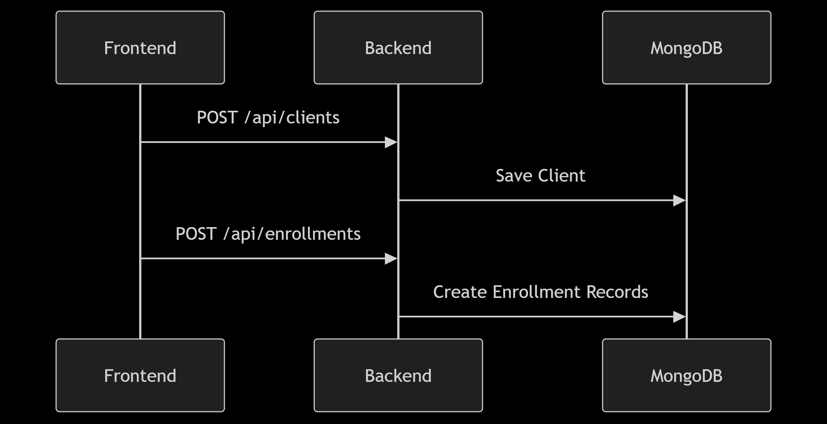
4: System Architecture Diagram

Slide 5
5: Implementation Details: Create Health Program
Goal: Allow doctors to create new health programs.
Implementation:
The system stores the program name, description, and any additional details.
The doctor can create multiple health programs (e.g., TB, HIV).
Code Snippet:
app.post('/createProgram', (req, res) => {
const { programName, description } = req.body;
// logic to store program in database
});

Slide 6
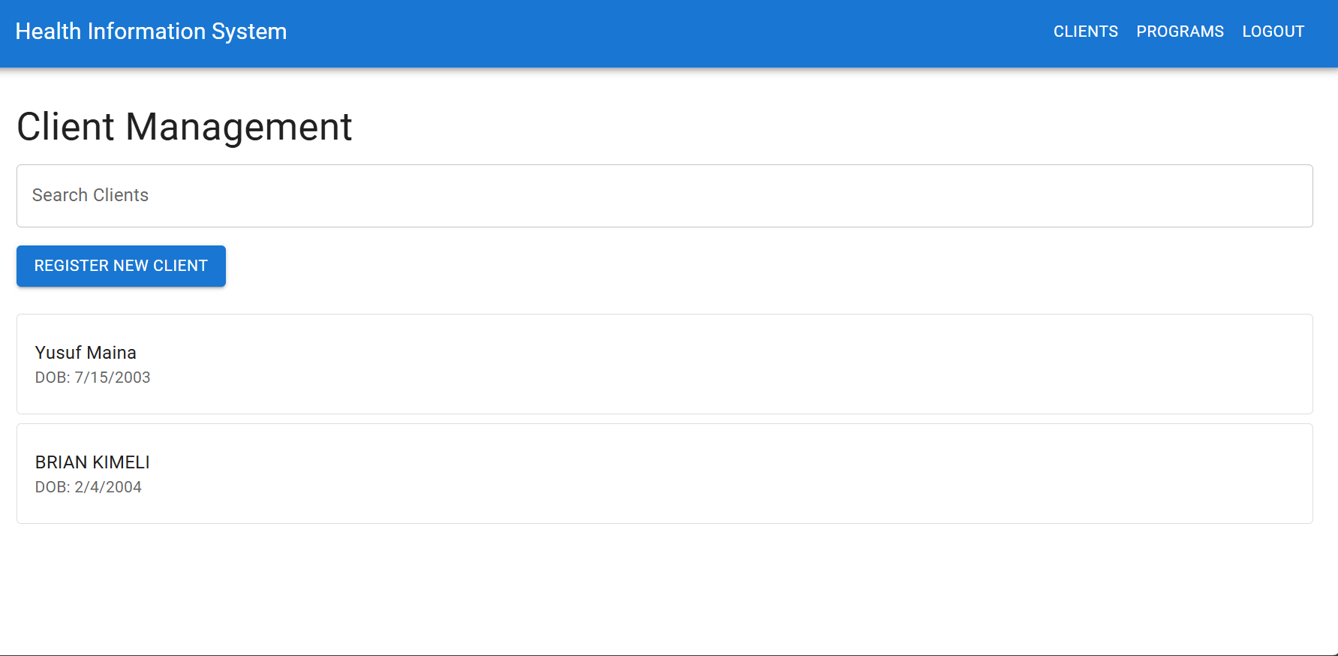
6: Implementation Details: Register New Client
Goal: Allow doctors to register new clients in the system.
Implementation:
The doctor enters client details such as name, age, contact, and medical history.
The client is stored in the database.

Slide 7
7: Implementation Details: Enroll Client in Program
Goal: Allow clients to enroll in one or more health programs.
Implementation:
Clients are associated with one or more health programs.
The doctor can assign a client to programs such as TB, Malaria, or HIV.

Slide 8
8: Authentication Flow
Doctor visits /login, submits username/password
Server verifies credentials & returns JWT
Frontend stores token in localStorage
Interceptor attaches Authorization: Bearer <token> to all API calls
Protected routes redirect to login if no valid token

Slide 9
9: Conclusion
• Key Achievements
Delivered a fully functional Health Information System
Doctors can create programs, register clients, enroll them, search & view profiles
Secure access via login + token-based auth
Profiles exposed through a clean, documented REST API

